Slide 1
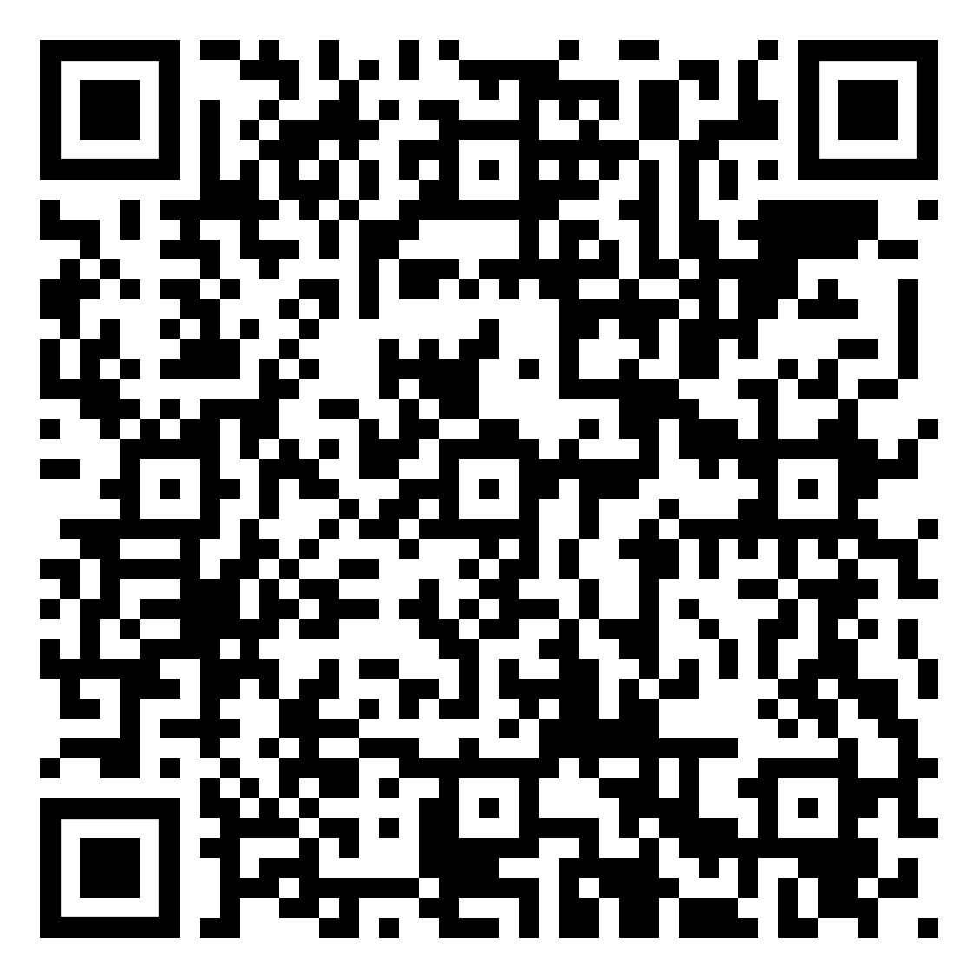
Today’s Schedule
First Period: 6:33 – 6:40
Second Period: 6:46 – 6:53
Third Period: 6:59 – 7:06
Fourth Period: 7:12 – 7:19
Fifth Period: 7:25 – 7:32
Six Period: 7:38 – 7:45
Welcome Back to School!
It’s a great day to be an Ayala Bulldog!
Sign In:

Slide 2
Today’s Agenda:
-Choose a seat.
-Use the QR Code to Sign-In
-Learn about Mrs. Yim
-Review the Behavior Matrix/Expectations
-Preview Units 1 - 6
-Texts and Materials
-Absences and late work
-Grading
-Book Report
Welcome Back to School!
It’s a great day to be an Ayala Bulldog!
Sign In:

Slide 3
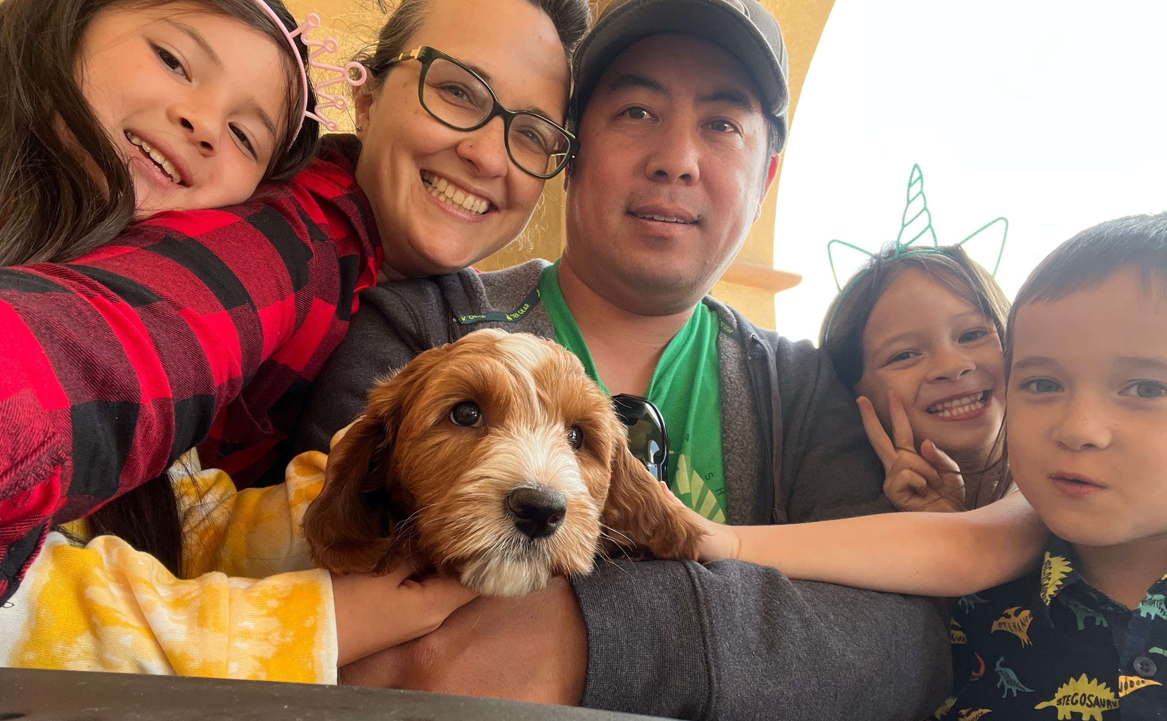
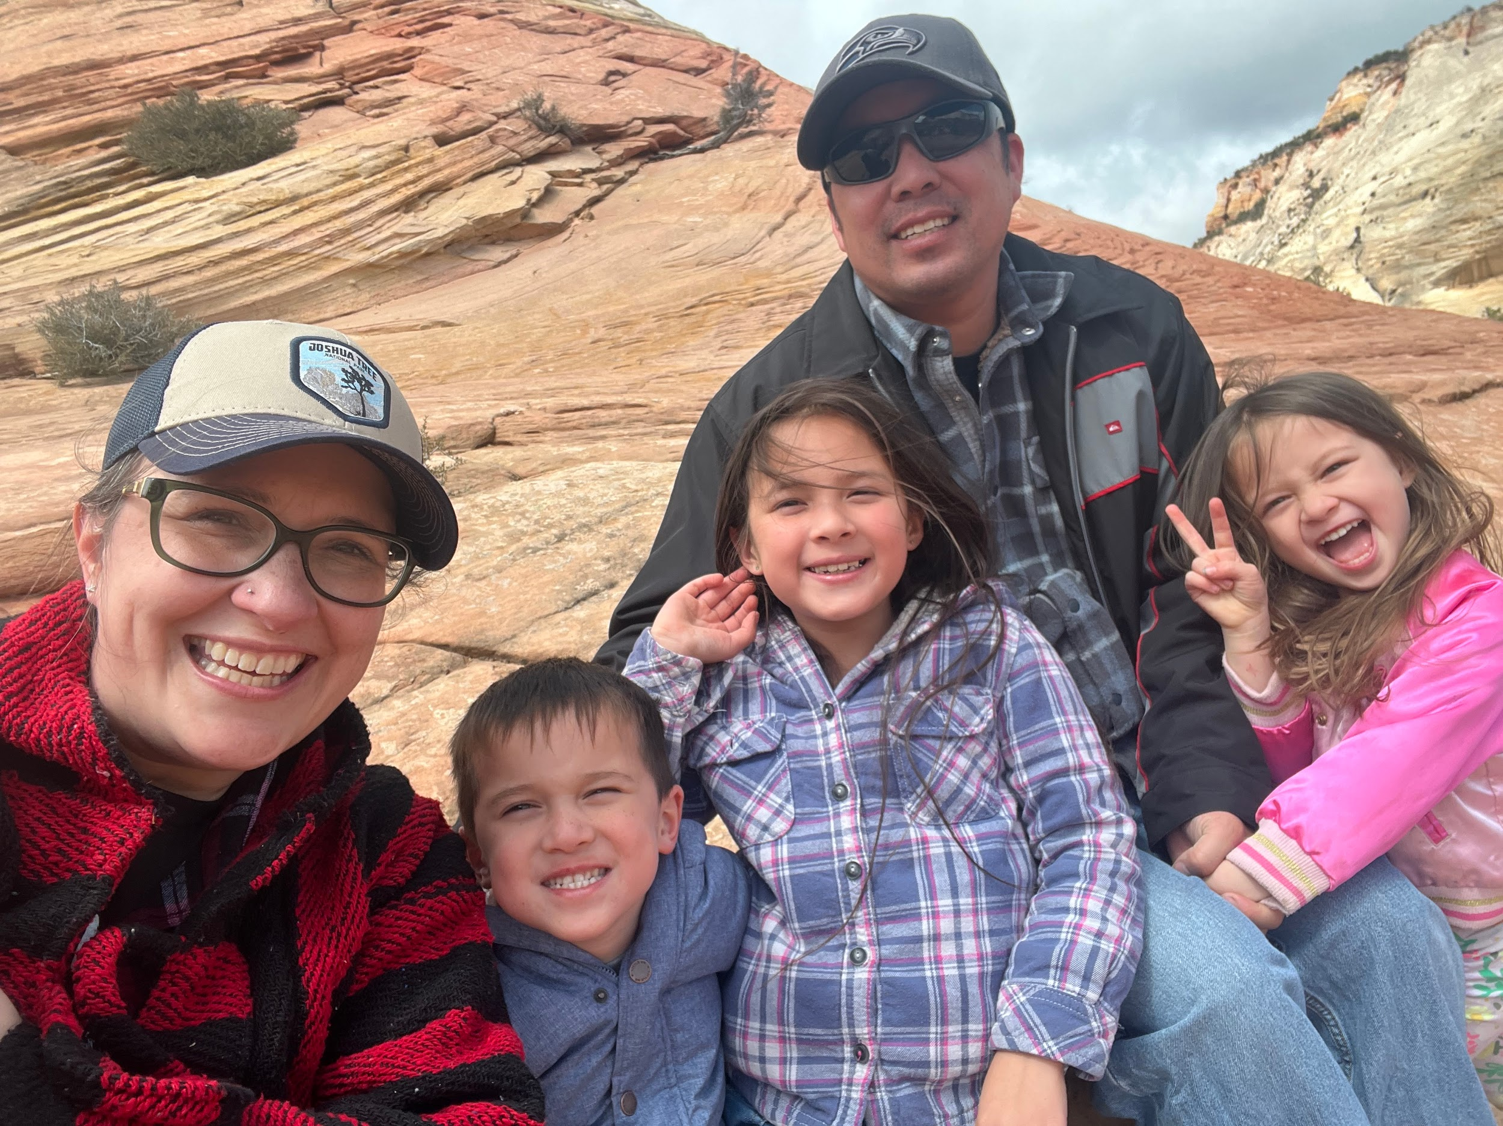
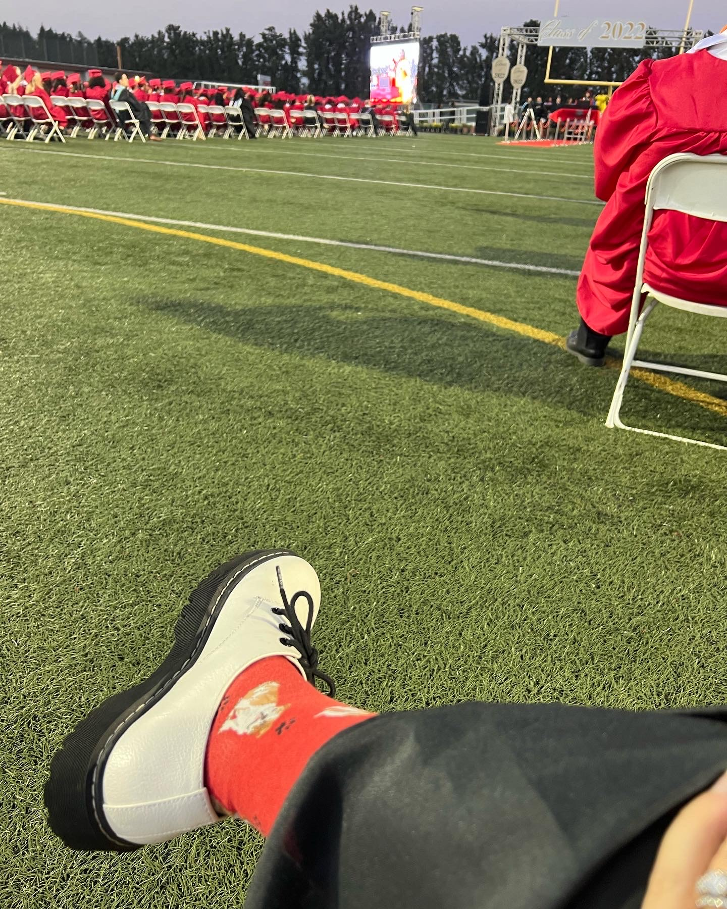
About Me - 🖤 I grew up in CA, AZ, and WA. 🖤 We are Seahawks and Mariners fans. 🖤 This is my 20th year teaching. 🖤 I have taught every grade from 1st to 9th. 🖤 Teaching 9th ELA is my favorite. 🖤 We enjoy visiting Joshua Tree and Disneyland. 🖤 I love 90’s alternative music. 🖤 I enjoy crafts and reading.🖤 I play ukulele. 🖤 I love supporting Ayala arts and athletics.
Meet Mrs. Yim
B.A. - Liberal Studies (MSMU)
M.A. - Teaching (USC)
M.O.M. to Lily (9), Zoe (6), Jackson (6) and Buster the Labradoodle .

Slide 4
Mrs. Yim’s Behavior Matrix
 | Be Respectful | Be Responsible | Be Safe
Arrival & Dismissal | ⬤ Enter and exit quietly. Have a positive attitude. Respect other’s personal space. Take out earbuds and put phones away | ⬤ Arrive on time with all necessary materials. ⬤ Be prepared to begin when the bell rings. Keep your area clean. | ⬤ Be aware of your surroundings. ⬤ Use all materials appropriately. ⬤ Don’t throw trash (or anything else). ⬤ Keep aisles clear. ⬤ Behave appropriately for a classroom environment. ⬤ Avoid divisive or hurtful language. ⬤ Take care of our classroom environment.
Whole Class & Group Collaboration | ⬤ Listen when others are speaking. ⬤ Value the contributions of your classmates and keep an open mind. | ⬤ Pay attention and participate. ⬤ Take notes. ⬤ Ask questions if you don’t understand. ⬤ Phones must be turned off and stored.
Independent Work & Assessments | ⬤ Work quietly without disturbing others. ⬤ Keep your eyes on your own work. | ⬤ Stay focused and use your time productively. ⬤Read directions carefully. ⬤ Do your best. ⬤ Use technology appropriately
Sign In:

Slide 5
Expectations
🖤 Respect me, respect each other, respect yourself, respect our classroom.
🖤 Try, especially when it’s difficult. I will support you.
🖤 Take responsibility for your learning. Ask questions when you don’t understand. Communicate with me if you need help.
Sign In:

Slide 6
Welcome Back to School!
1st Semester
🖤 Unit 1: American Voices (Speeches and essays.)
🖤 Unit 2: Character and Claim (Lord of the Flies)
🖤 Unit 3: Arguments in Action (Nonfiction Articles)
2nd Semester
🖤 Unit 4: Archetype and the Hero’s Journey (The Odyssey and Greek Mythology
🖤 Unit 5: Delving into Character (Romeo and Juliet)
🖤 Unit 6: Researching Current Events (Nonfiction and Articles)
It’s a great day to be an Ayala Bulldog!

Slide 7
Texts and Materials
🖤 Articles and stories from the textbook - Perspectives. Students may bring the book or remove the article or story we are reading.
🖤 Lord of the Flies (not in textbook; can purchase or check out from school library - will need mid September)
🖤 Highlighters (various colors) and small sticky notes are useful for annotating.
Sign In:

Slide 8
Absences and Late Work
🖤 Assignments and instructions are posted daily in Google Classroom.
🖤 Late work will be accepted in person (during lunch or after school) for up to 70% credit until the end of the unit.
🖤 Students should communicate with me regarding extended illnesses or absences to make a plan to catch up.
Sign In:

Slide 9
Welcome Back to School!
Grades:
Categories
89.5 - 100 % | A
79.5 - 89.0% | B
69.5 - 79.4% | c
59.5 - 69.4% | D
0-59.4% | F
Writing ( essays, journals) | 30%
Reading (book reports, vocabulary, unit tests) | 20%
Speaking and Listening (Debates, Discussions, Socratic Seminars, Presentations) | 20%
Classwork / Homework | 30%
It’s a great day to be an Ayala Bulldog!

Slide 10
Book Report / SSR
🖤 Each quarter ( 8-9 weeks), students will be required to read a minimum of 200 pages.
🖤 Books must be at student’s reading level, not required reading for school, and something they enjoy.
🖤 Assignment: 1 pager (in Google Classroom) due 10/3
Sign In:

Slide 11
Communication:
-Google Classroom
-email: robin_yim@chino.k12.ca.us
-After school office hours: Days posted weekly in Google Classroom
We are a team. If you have questions or if there is anything I can clarify, please let me know.
Thank you for coming!
I am so excited to work with your amazing student
this year.
Sign In:

